Slide 1
DOCTOR ONLINE
MOBILE APPLICATION for applied project
Group Members:
R P N Mithun - 4645651
U T Sellahewa – 4645654
T. Egodage – 4645639
K. Sandalee Suvimanee - 4633601

Slide 2



Slide 3

What is Doctor Online?

Slide 4
More than 60% Using Smart Phones and health care is most untapped market in the context of mobile phones. The health care applications can help to improve the health care industry making service speedy and effective.

Slide 5

THE BENEFITS OF DOCTOR ONLINE
Helpful for patients
Helpful for doctors
Cost effective
Time not wasted for waiting ques to buy medicine
Online payment methods
Doctors and patients can video Conference each other
You can use symptoms checker to identify your illness

Slide 6

Stakeholders
This app is built for the patients, doctors, young and older generations, means any one can use this application for medical purposes.

Slide 7

Data Base Design
Google fire base
-Real-time Database Helps to Store and Synchronize Data
-Firebase Offers Facility of Crash Reporting to Fix Bugs Quickly
-Fast and Secured Web Hosting
-Firebase Allows the Content Storage with Ease
-Send Notifications and Messages to Targeted Audiences

Slide 8
App Functionality
Using the Doctor Online You can call Emergency “1990” through connecting the GPS signals in mobile phone.
You can check the symptoms of your illness by the symptoms checker by tapping it. Then you can identify or search by image option with google and you can know some details about your illness, what are the medicine for it or channel a doctor for the current situation.
The app will push notifications about to avoid from COVID- 19 and some good health habits to live a healthy life.

Slide 9
Some features
Telemedicine
Emergency Calls
Symptoms Checker
Notification Pusher
User Friendly Interface
Medicine ordering

Slide 10
App Non functionality
It may gain some seconds to load up the Application.
Some issues can be happen due to the android version of the smart phone
App security
App will slow down the performance because of system is load with many users.

Slide 11
For avoiding these situations we done some actions
Performance Testing
Stress Testing
Load Testing
Volume Testing
Usability Testing
Recovery Testing
Compatibility Testing
Instability Testing
Documentation Testing

Slide 12
USER INTERFACE FIRST VIEW
This is the first page of the application.
The button showing let’s begin is to,
go for the next page.

Slide 13
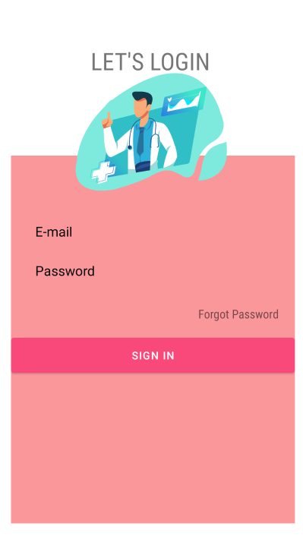
SECOND VIEW AND LOGIN
This is the second page of the
Application and it shows the login.

Slide 14
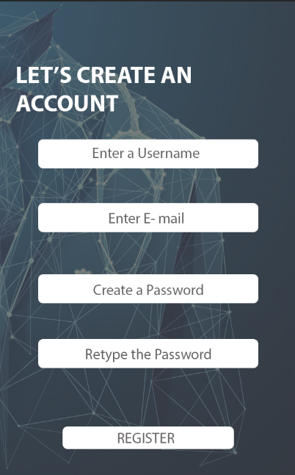
CREATE AN ACCOUNT THIRD VIEW
This is the third page of the Application
and this is the page where we
Creating a New Account
Click here to Register

Slide 15
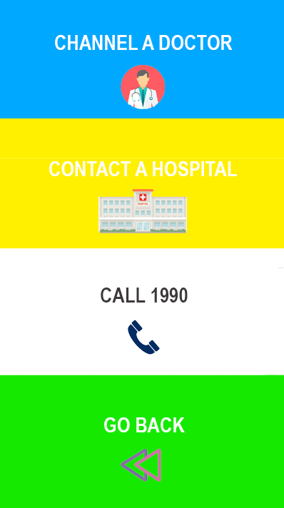
4TH VIEW
This is the fourth page of the application,
in this page you can:
Channel a Doctor
Contact a Hospital
Call 1990
Go back

Slide 16
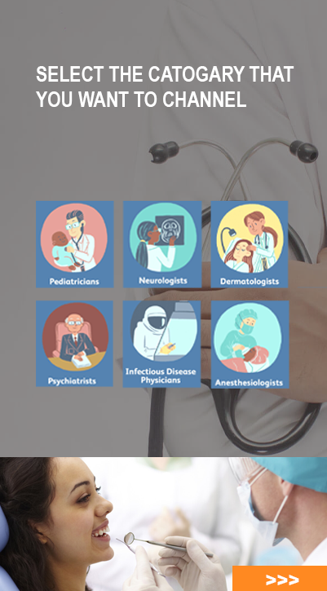
CHANNEL A DOCTOR
This is the view of fifth page of the Application.
You can select the doctor category that,
You need to channel.

Slide 17
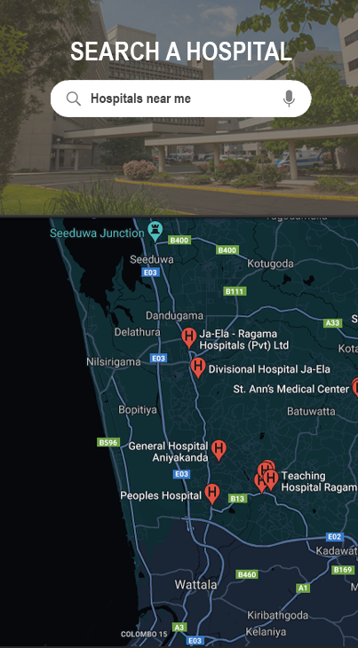
CONTACT A HOSPITAL
This is the sixth page of the Application
and you can search a hospital that near
by you and it will give the contact details
via the google maps.

Slide 18

EMEGERNCY CALLS
This is the seventh page of the Application.
You can contact 1990 as the Emergency
Service by clicking Call Now button.
Call now Button

Slide 19
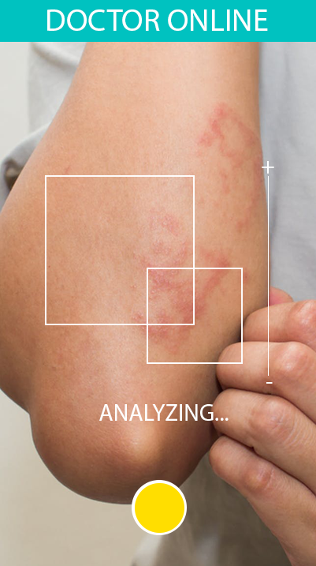
SYMPTOMS CHECKER

Slide 20
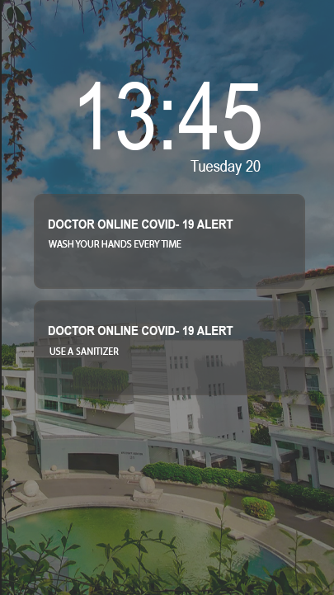
COVID- 19 NOTIFICATIONS
This is the last page of the Application
And This will push notifications to
Prevent COVID- 19.

Slide 21
THE END
Q&A

